Slide 1
Plant Cultivation
and Monitoring Solution
using IOT and ML

Slide 2

PROBLEM STATEMENT
Sri Lanka's agricultural sector has seen limited progress since independence, lagging notably behind other nations that have embraced modern technologies like the Internet of Things (IoT) and Machine Learning (ML). While these advancements have revolutionized farming globally, increasing production and efficiency, their adoption in Sri Lanka remains minimal.
Technological Gap
There's a significant absence of advanced technologies such as IoT and ML in the local agricultural practices.
Geographical and Climatic Diversity
Sri Lanka's diverse agricultural landscape, varying widely across different regions in climate and geography, poses a unique challenge. The Central Province and the North Central Province, for example, differ greatly in temperature and precipitation, affecting what crops can feasibly be cultivated.

Slide 3
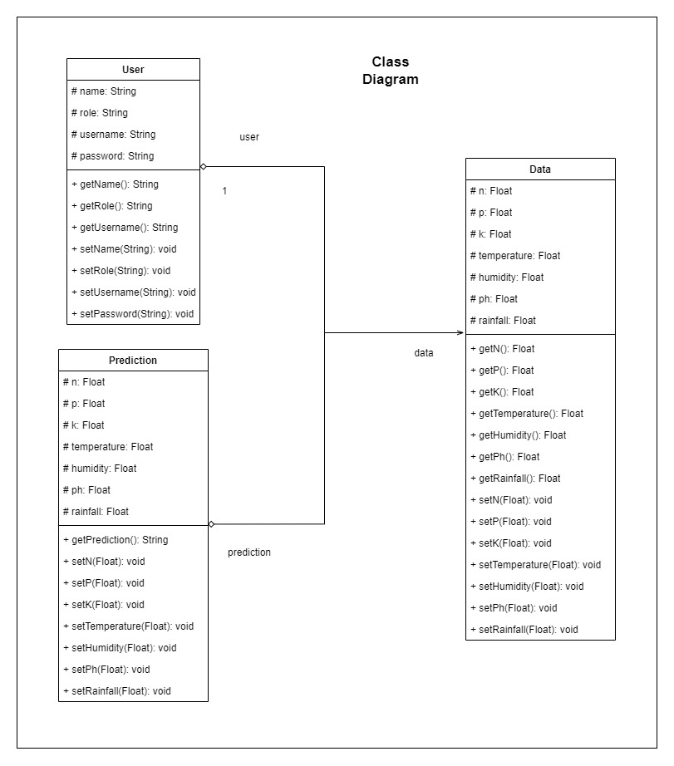
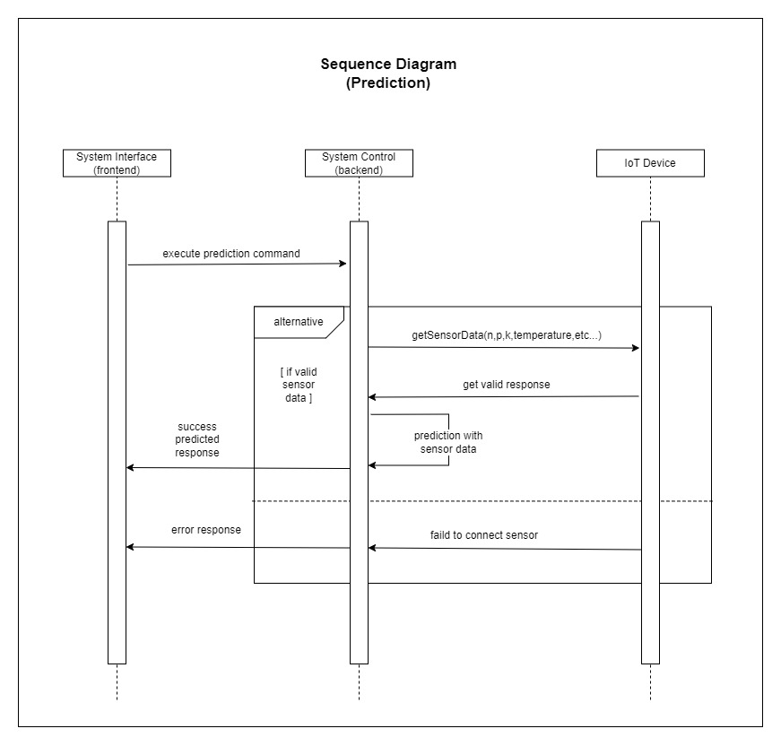
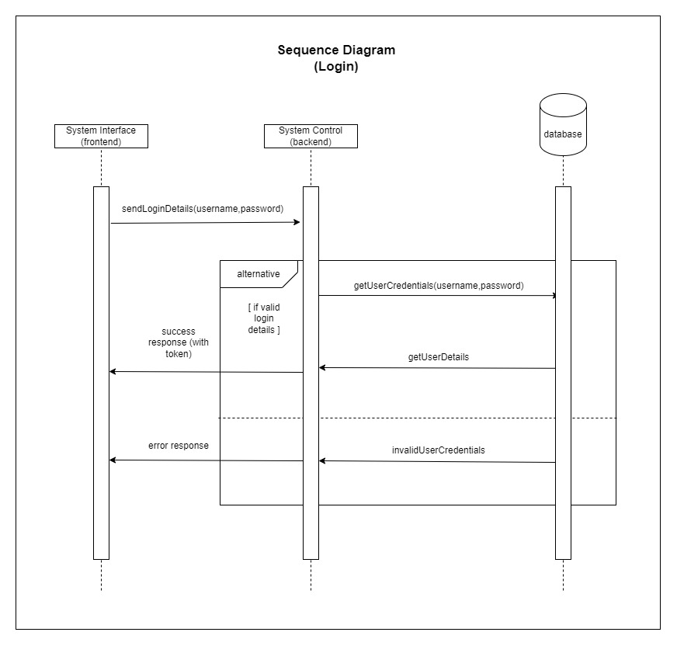
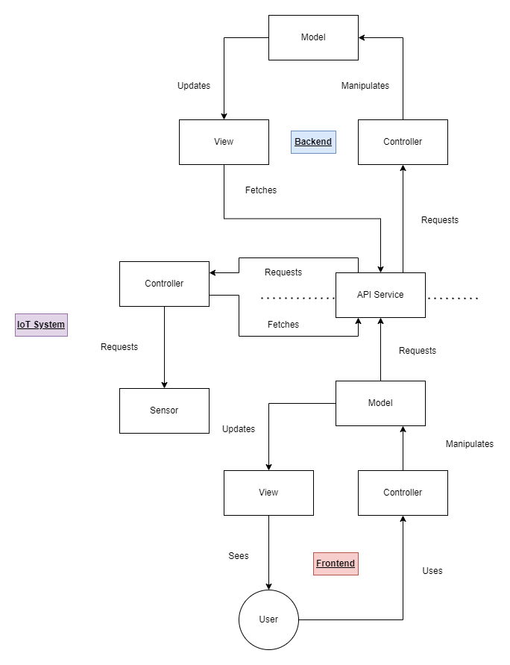
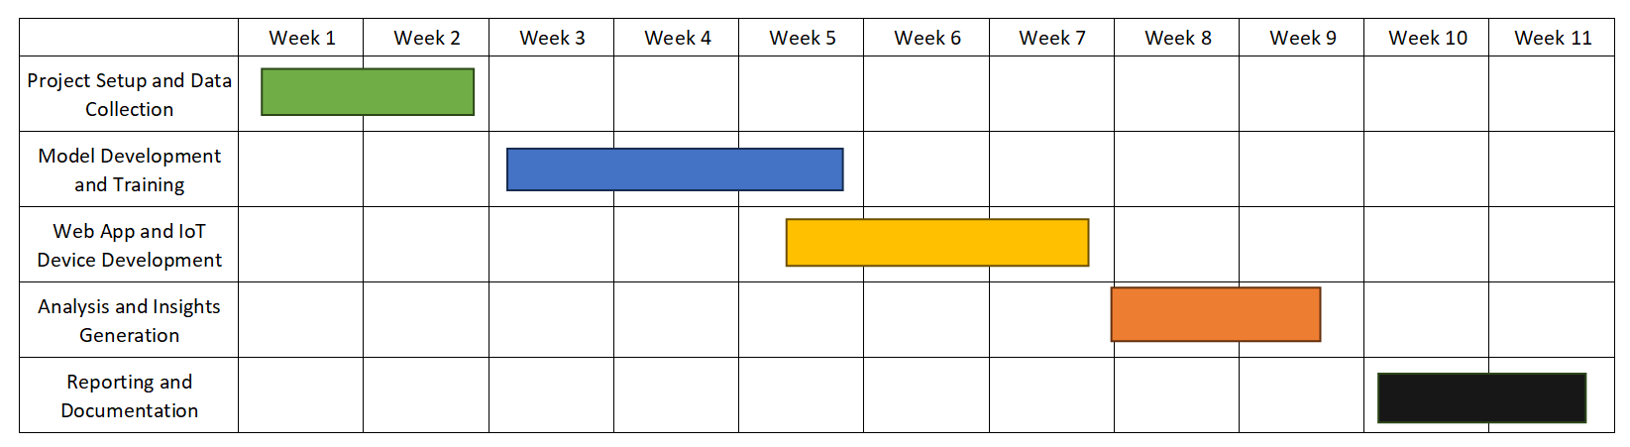
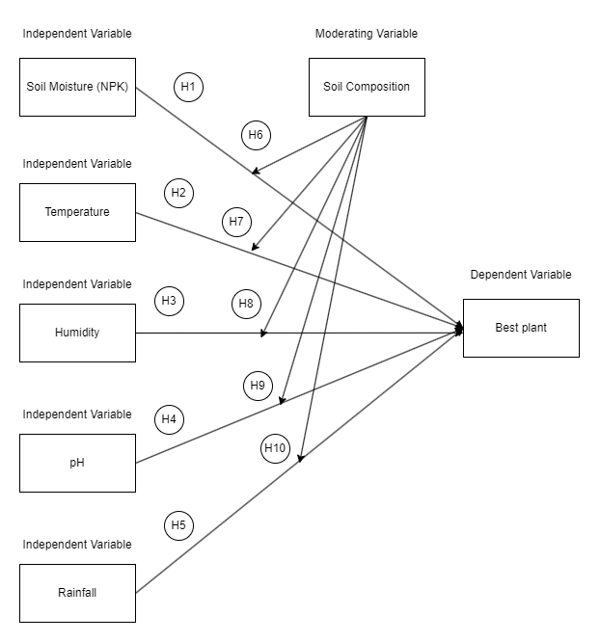
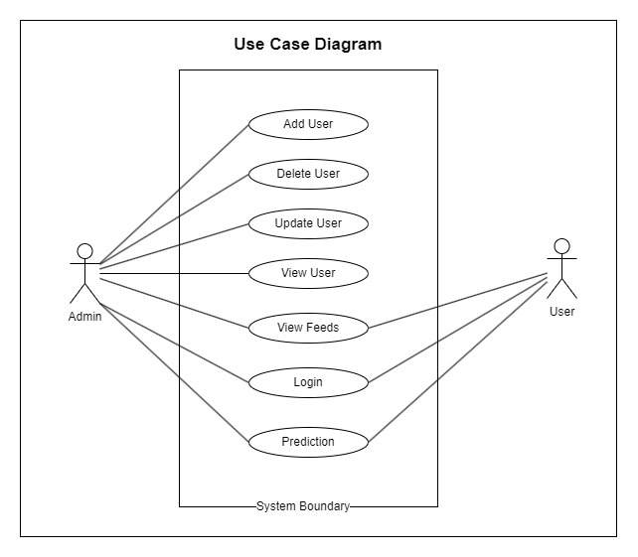
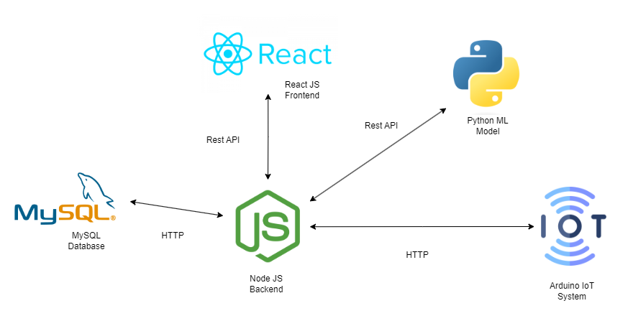
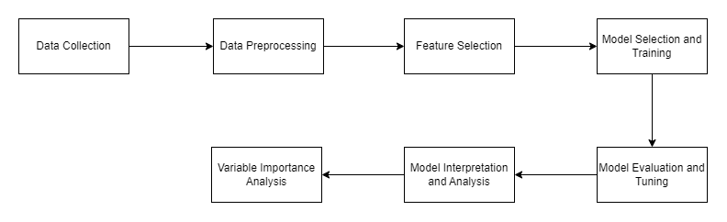
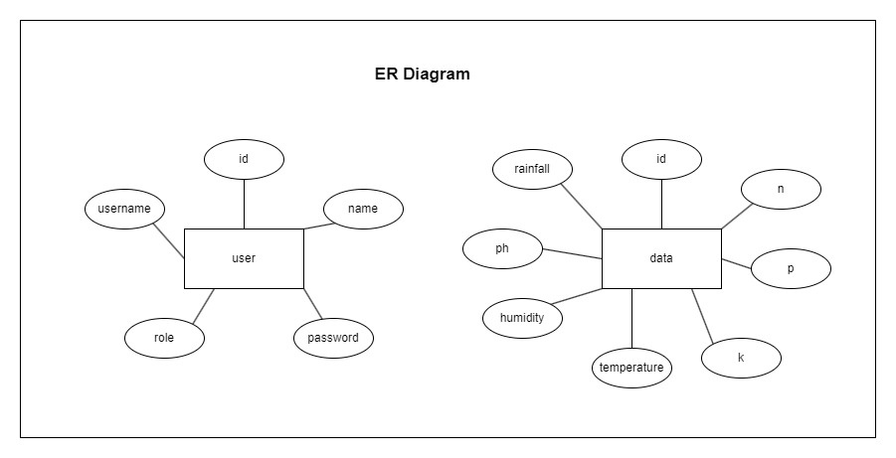
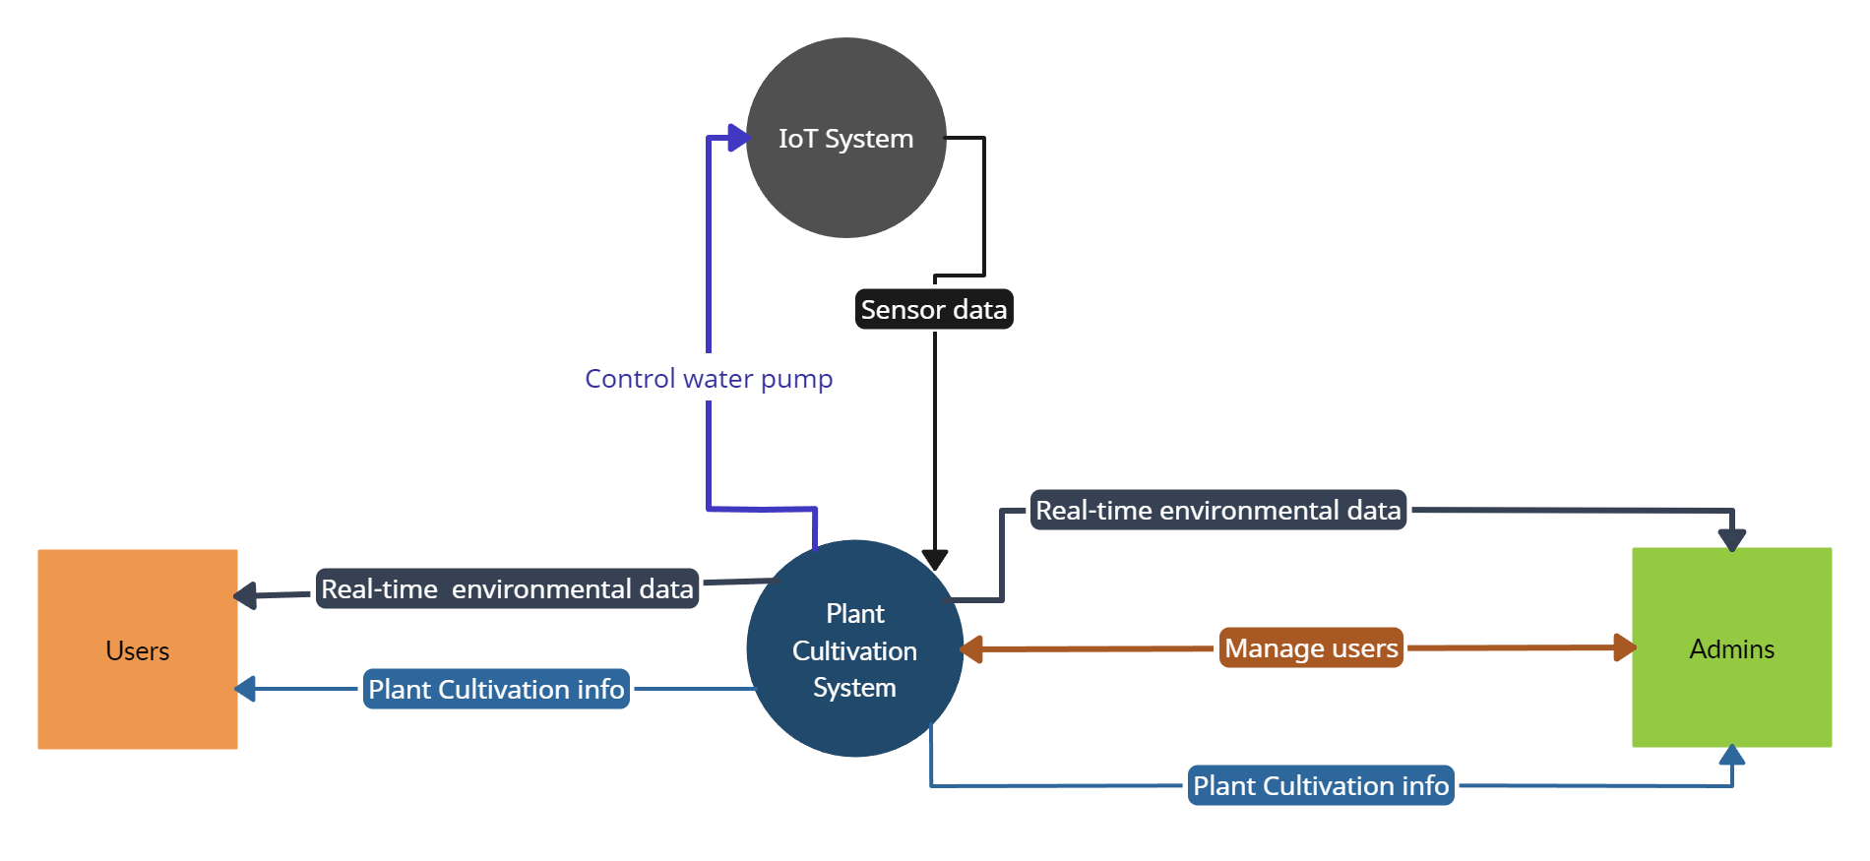
SYSTEM DIAGRAMS

Slide 4
DESIGN OVERVIEW

Slide 5
USE CASE
DIAGRAM

Slide 6
SEQUENCE
DIAGRAM
(Login)

Slide 7
SEQUENCE
DIAGRAM
(Prediction)

Slide 8
CLASS
DIAGRAM

Slide 9
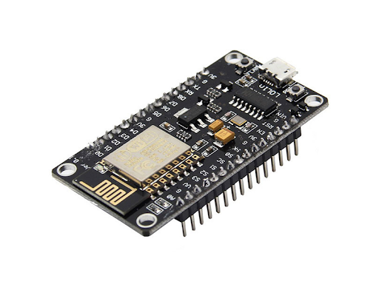
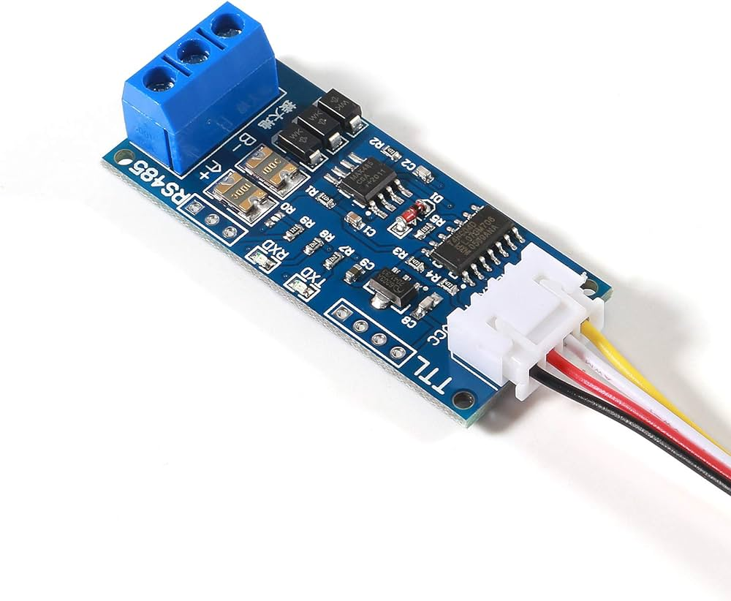
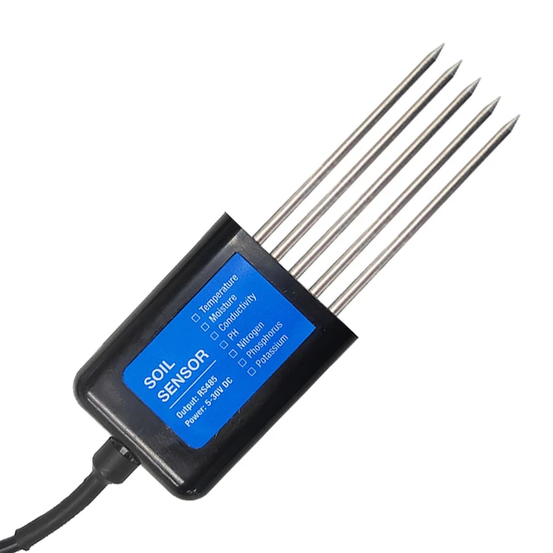
IOT DEVICE COMPONENTS
NodeMCU V3 Wi-Fi Development Board
TTL to RS485 Adapter
Soil Moisture, Temperature, Humidity, PH, NPK Sensor

Slide 10
LITERATURE REVIEW
literature review delves into the current state of IoT and Machine Learning applications within the agricultural sector. It compiles insights from various studies that demonstrate how these technologies have revolutionized farming worldwide. This includes enhancements in predictive analytics for crop yields, optimized resource management, and advanced environmental monitoring. Also explore the specific barriers and breakthroughs in technology adoption across different agricultural settings, focusing on how these innovations can be tailored to Sri Lanka's unique agricultural conditions. This comprehensive analysis establishes a robust foundation for understanding how IoT and ML can significantly contribute to advancing agricultural practices, supporting the innovative approaches proposed in the project.

Slide 11
LITERATURE REVIEW
Dependent Variable
Best Plant (label)
Independent Variable
Soil Moisture (NPK)
Temperature
Humidity
Ph
Rainfall

Slide 12
CONCEPTUAL
DIAGRAM
This conceptual diagram illustrates framework for leveraging advanced technologies in agriculture. It begins with environmental and soil data as inputs, gathered via IoT sensors, which are then processed through our machine learning system. The outcome is precise predictions of optimal crop choices, tailored to the specific climatic and geographical characteristics of different regions in Sri Lanka, aiming to enhance agricultural efficiency and diversity.

Slide 13
RESEARCH ANALYSIS
The Research Analysis section of the presentation scrutinizes the data collected from IoT sensors and analysed through the machine learning models. This section evaluates the effectiveness of integrating advanced technologies into Sri Lankan agriculture, assessing their impact on crop selection and cultivation efficiency. Systematically analyse the patterns and outcomes derived from our predictive models to determine the most suitable crops for various regions, considering local environmental and soil conditions. This analysis not only validates hypothesis but also demonstrates the potential of IoT and ML to enhance agricultural productivity and sustainability in Sri Lanka.
Data Insights
Model Performance
Present significant patterns and insights discovered through the analysis of IoT data
Share results regarding the accuracy and reliability of the machine learning models.

Slide 14



DESIGN (Login)

Slide 15
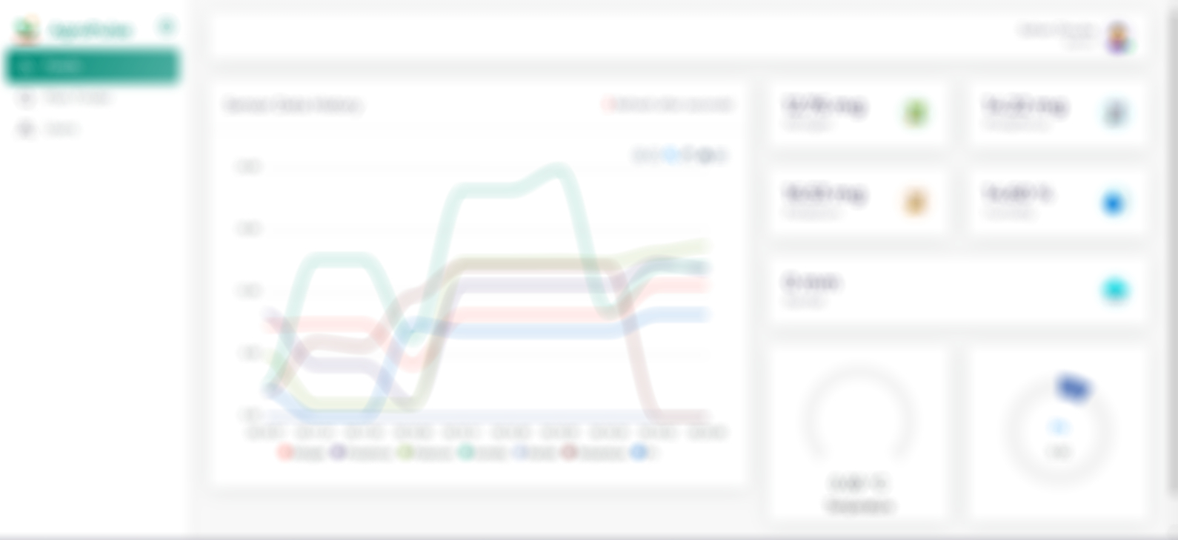

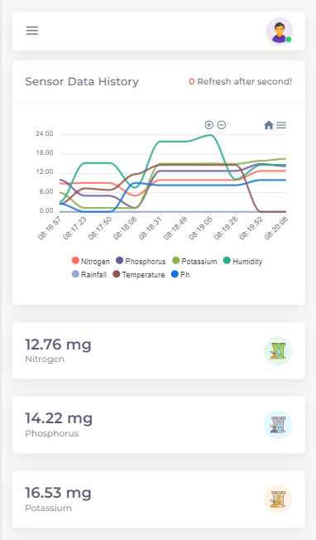
DESIGN (Dashboard)

Slide 16



DESIGN (Users)

Slide 17

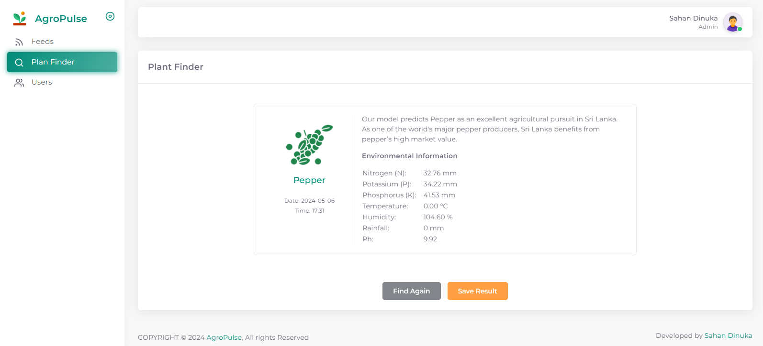
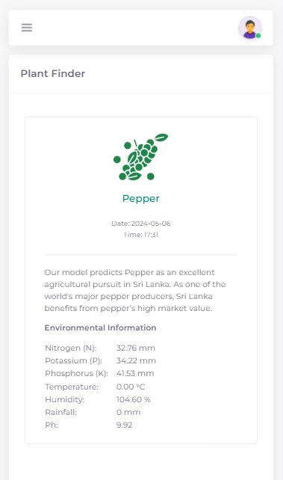
DESIGN (Prediction)

Slide 18

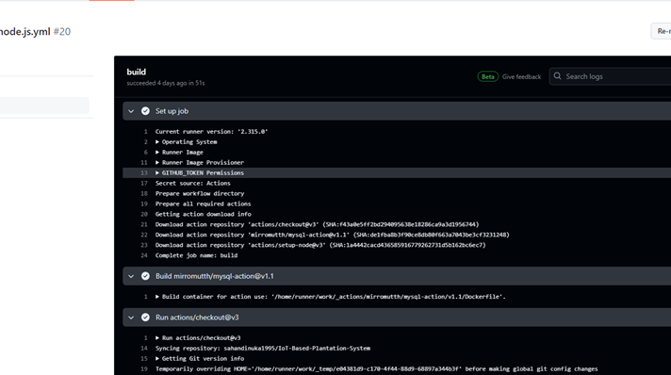
GITH ACTION TEST RESULTS

Slide 19
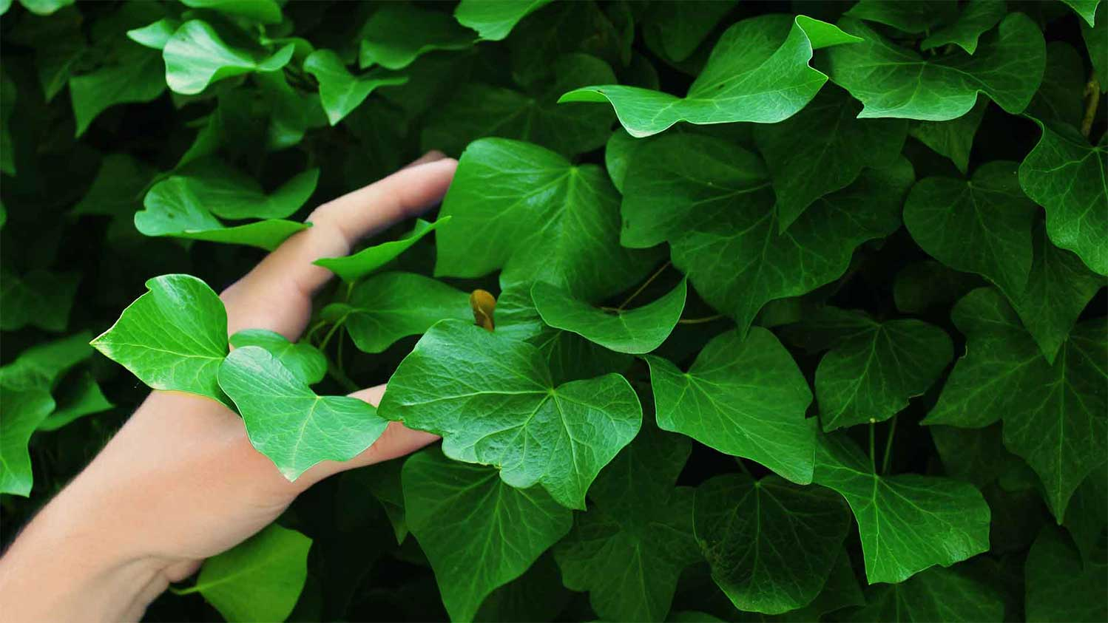
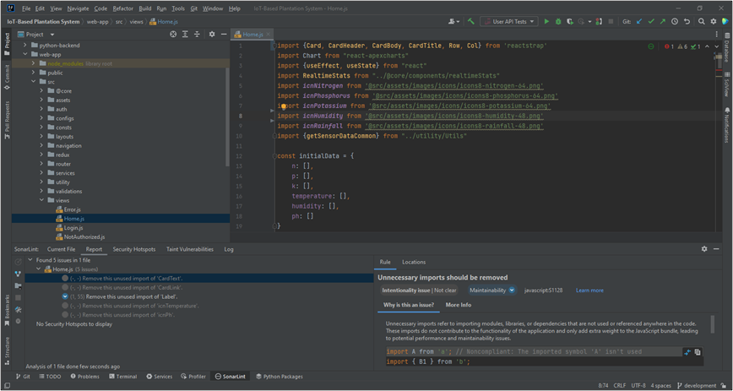
SONARLINT CODE QUALITY TEST

Slide 20
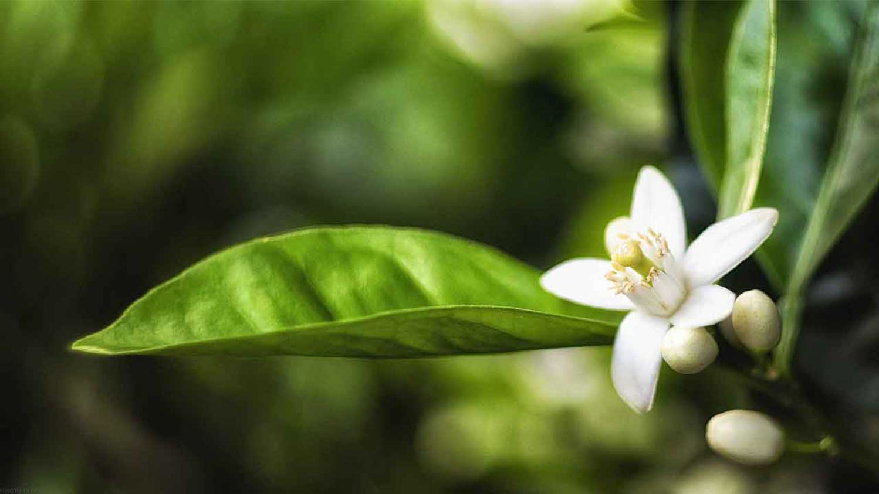

UI AUTOMATION TEST RESULT

Slide 21
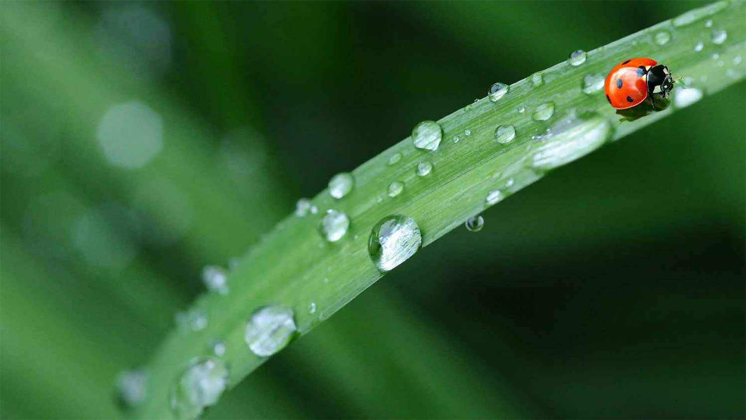
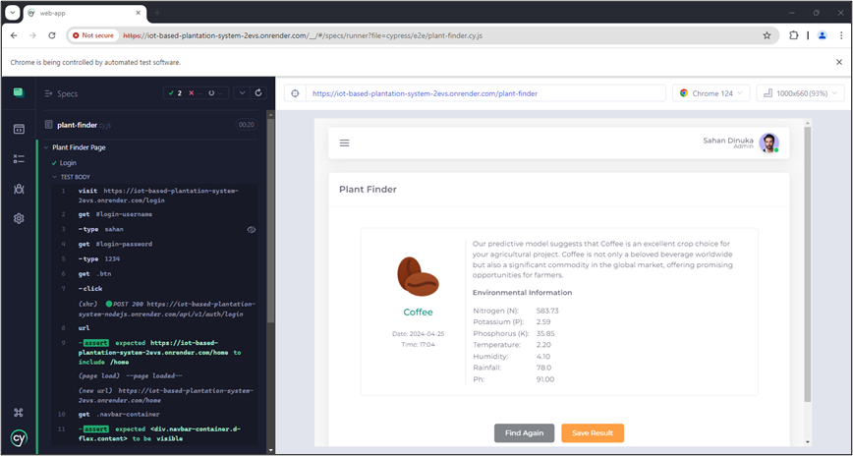
UI AUTOMATION TEST RESULT

Slide 22

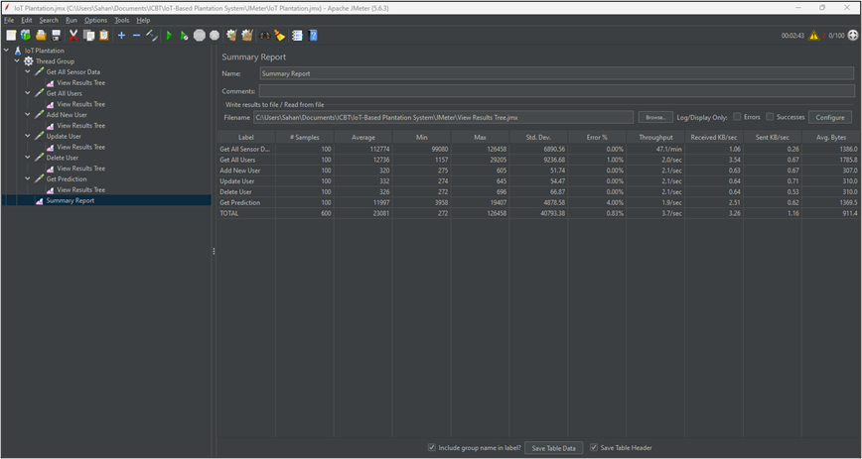
LOAD & PERFORMANCE TEST RESULT

Slide 23
CONCLUSION
This research demonstrated that the integration of Internet of Things (IoT) and Machine Learning (ML) technologies can significantly enhance crop selection processes and overall agricultural productivity in Sri Lanka.
The application of these technologies enabled precise monitoring and analysis of environmental and soil conditions, leading to more informed and effective farming decisions.
By adapting agriculture to technological advancements, Sri Lanka can improve food security, increase export opportunities, and bolster the national economy.

Slide 24
REFERENCES
1) AbdelRahman, M. A. E., Saleh, A. M., & Arafat, S. M. (2022). Assessment of land suitability using a soil-indicator-based approach in a geomatics environment. Scientific Reports, 12(1). https://doi.org/10.1038/s41598-022-22727-7
2) Abubakar, A., Ishak, M. Y., Uddin, M. K., Abu Bakar, A., & Mohammed, M. U. (2023). What does Modelling Tells us on the Influence of Certain Weather Parameters on Oil Palm Production in Peninsular Malaysia. Indian Journal of Agricultural Research, 57(1). https://doi.org/10.18805/IJARe.AF-715
3) Affoh, R., Zheng, H., Zhang, X., Yu, W., & Qu, C. (2023). Influences of Meteorological Factors on Maize and Sorghum Yield in Togo, West Africa. Land, 12(1). https://doi.org/10.3390/land12010123
4) Ahmed, U., Lin, J. C. W., Srivastava, G., & Djenouri, Y. (2021). A nutrient recommendation system for soil fertilization based on evolutionary computation. Computers and Electronics in Agriculture, 189. https://doi.org/10.1016/j.compag.2021.106407
5) Alhajj Ali, S., Vivaldi, G. A., Garofalo, S. Pietro, Costanza, L., & Camposeo, S. (2023). Land Suitability Analysis of Six Fruit Tree Species Immune/Resistant to Xylella fastidiosa as Alternative Crops in Infected Olive-Growing Areas. Agronomy, 13(2). https://doi.org/10.3390/agronomy13020547
8) Baldini, M., Ferfuia, C., Zuliani, F., & Danuso, F. (2020). Suitability assessment of different hemp (Cannabis sativa L.) varieties to the cultivation environment. Industrial Crops and Products, 143. https://doi.org/10.1016/j.indcrop.2019.111860
9) Chiu, M. C., Chen, C. L., Chen, C. W., & Lin, H. J. (2022). Weather fluctuation can override the effects of integrated nutrient management on fungal disease incidence in the rice fields in Taiwan. Scientific Reports, 12(1). https://doi.org/10.1038/s41598-022-08139-7
10) Confalonieri, R., Francone, C., Cappelli, G., Stella, T., Frasso, N., Carpani, M., Bregaglio, S., Acutis, M., Tubiello, F. N., & Fernandes, E. (2013). A multi-approach software library for estimating crop suitability to environment. Computers and Electronics in Agriculture, 90. https://doi.org/10.1016/j.compag.2012.09.016

Slide 25

THANK YOU

